Slide 1
Agile on Board or How We Do It at Intel
Artem Fedko
Copyright © 2013 Intel Corporation. All rights reserved
Intel are trademark of Intel Corporation in the U.S. and/or other countries.

Slide 2
Embedded in a „normal” way
Requirements
Design
Code
Test
Integrate

Slide 3

TTM & “Shift left”
Time to Market.
In modern world the time to market for a new product generation is getting shorter and shorter.
Shift left.
Deliver a high level of readiness early in the developing cycle.
Hardware
Firmware

Slide 4
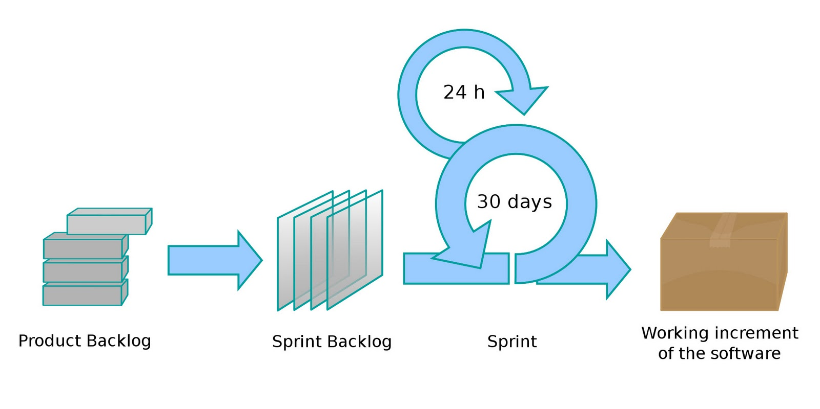
Agile

Slide 5
Prototyping
What to do if there is no hardware yet?
Using a previous generation platform.
Hybrid Virtual Platforms (FPGA).
Simulation boards.

Slide 6


Team members interchangeability.
High level programming.
Low level programming.

Slide 7
Waterfall in agile disguise
Validation after Development.
Separating development and validation.
VAL 1
DEV 1
DEV 2
VAL 2
Sprint 1
Sprint 2
Sprint 3
Feature development and its validation should be done in the same sprint.
DEV 1
DEV 2
VAL 1
VAL 2
Sprint 1
Sprint 2
Sprint 3

Slide 8
Multiple mini waterfalls
Waterfall inside single iteration.
DEV 1
DEV 2
VAL 1
VAL 2
Sprint 1
Sprint 2
Sprint 3
Feature development and tests development should be done in parallel.
DEV 1
DEV 2
VAL 1
VAL 2
Sprint 1
Sprint 2
Sprint 3

Slide 9
Continuous testing
Test development along with firmware development process.
Test portfolio creation.
Regression testing.
Nightly testing.
Pass rate.

Slide 10
Tests automation.
Automatic test environment.
Farm of the test sets.
Basic tests after each build.
Device Under the Test
Tests Framework
Tests Results

Slide 11

Unit tests
Eliminates the number of issues on the early stage.
Decrease the validation team effort.
Decrease number of the potential defects.
Improve planning and team velocity.

Slide 12

Customers feedback
Each sprint is a small product release.
Customer gives a feedback.
BACKLOG
Sprint
Sprint
Sprint

Slide 13
Q&A

